Slide 1

Estimating high-resolution profiles of wind speeds from a global reanalysis dataset using TabNet
Harish Baki, Geosciences and Remote Sensing, Faculty of Civil Engineering & Geosciences, TU Delft
Sukanta Basu, Atmospheric Sciences Research Center, University at Albany

Slide 2
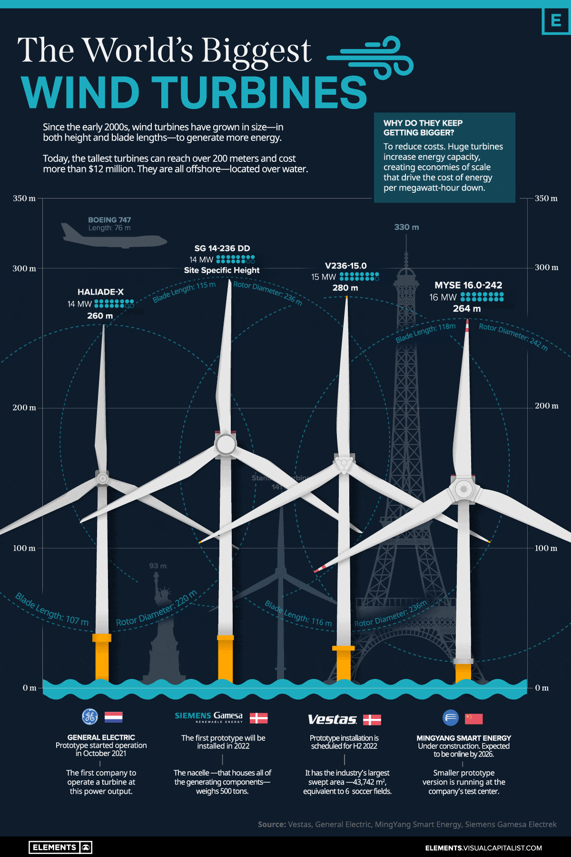
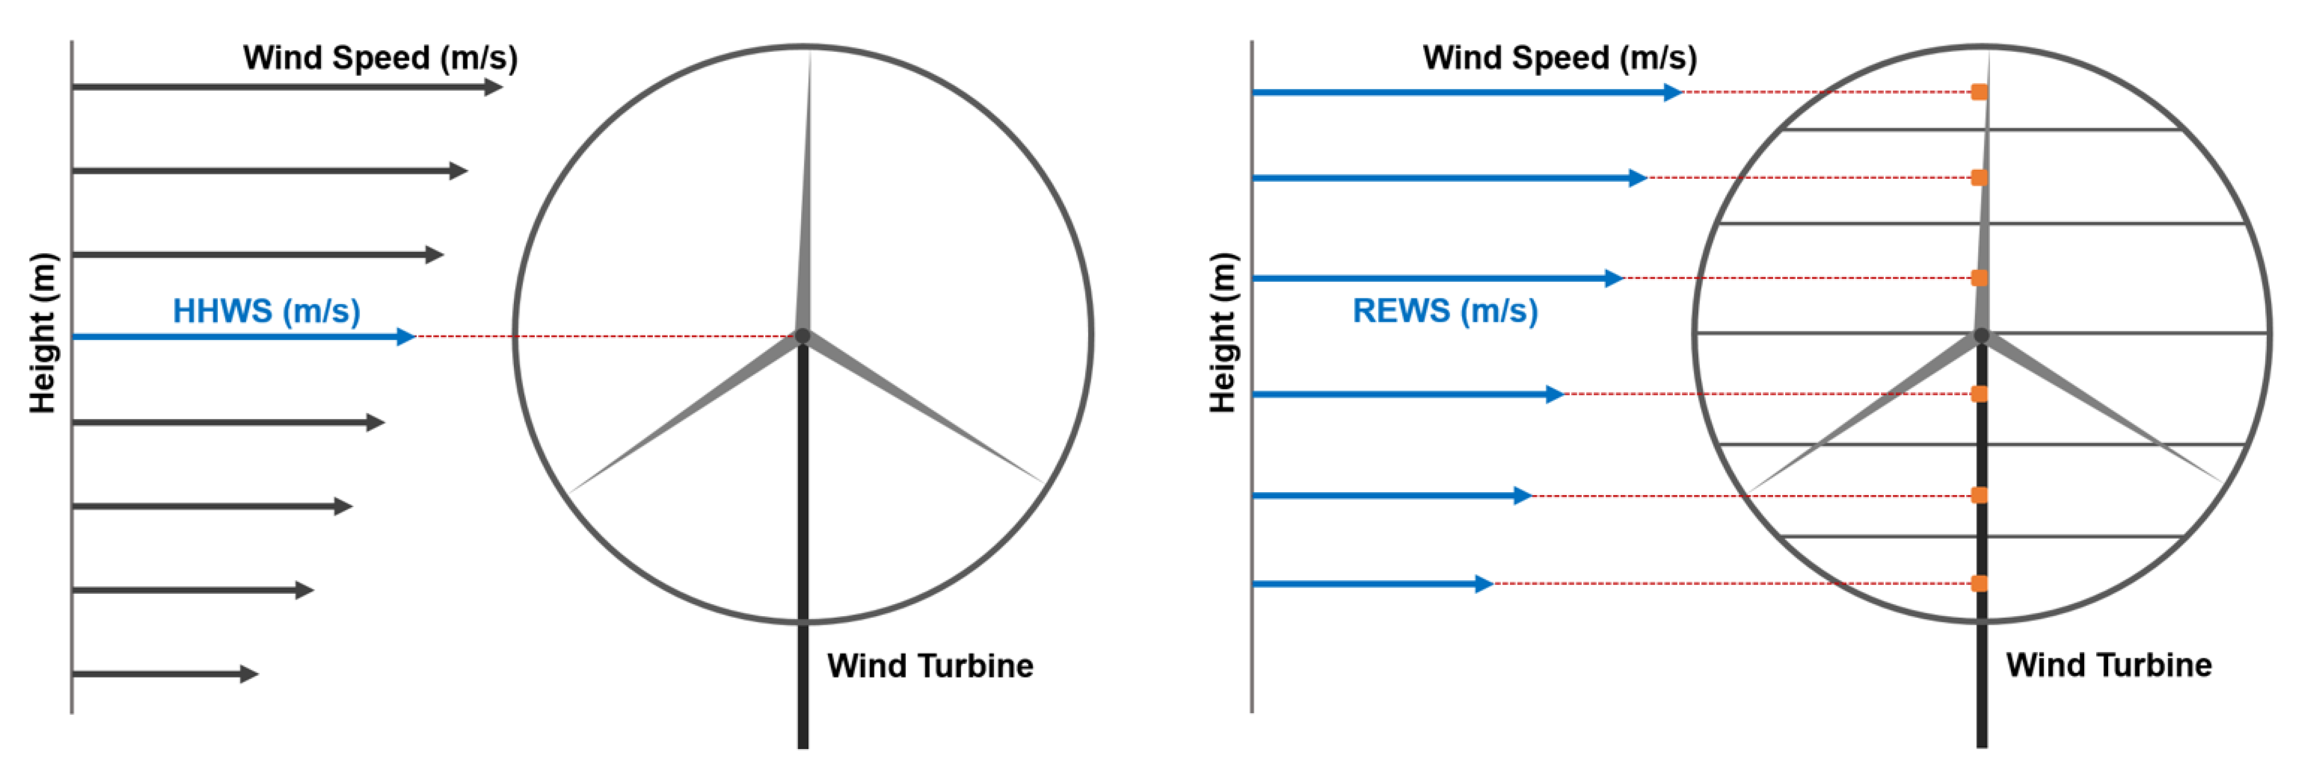
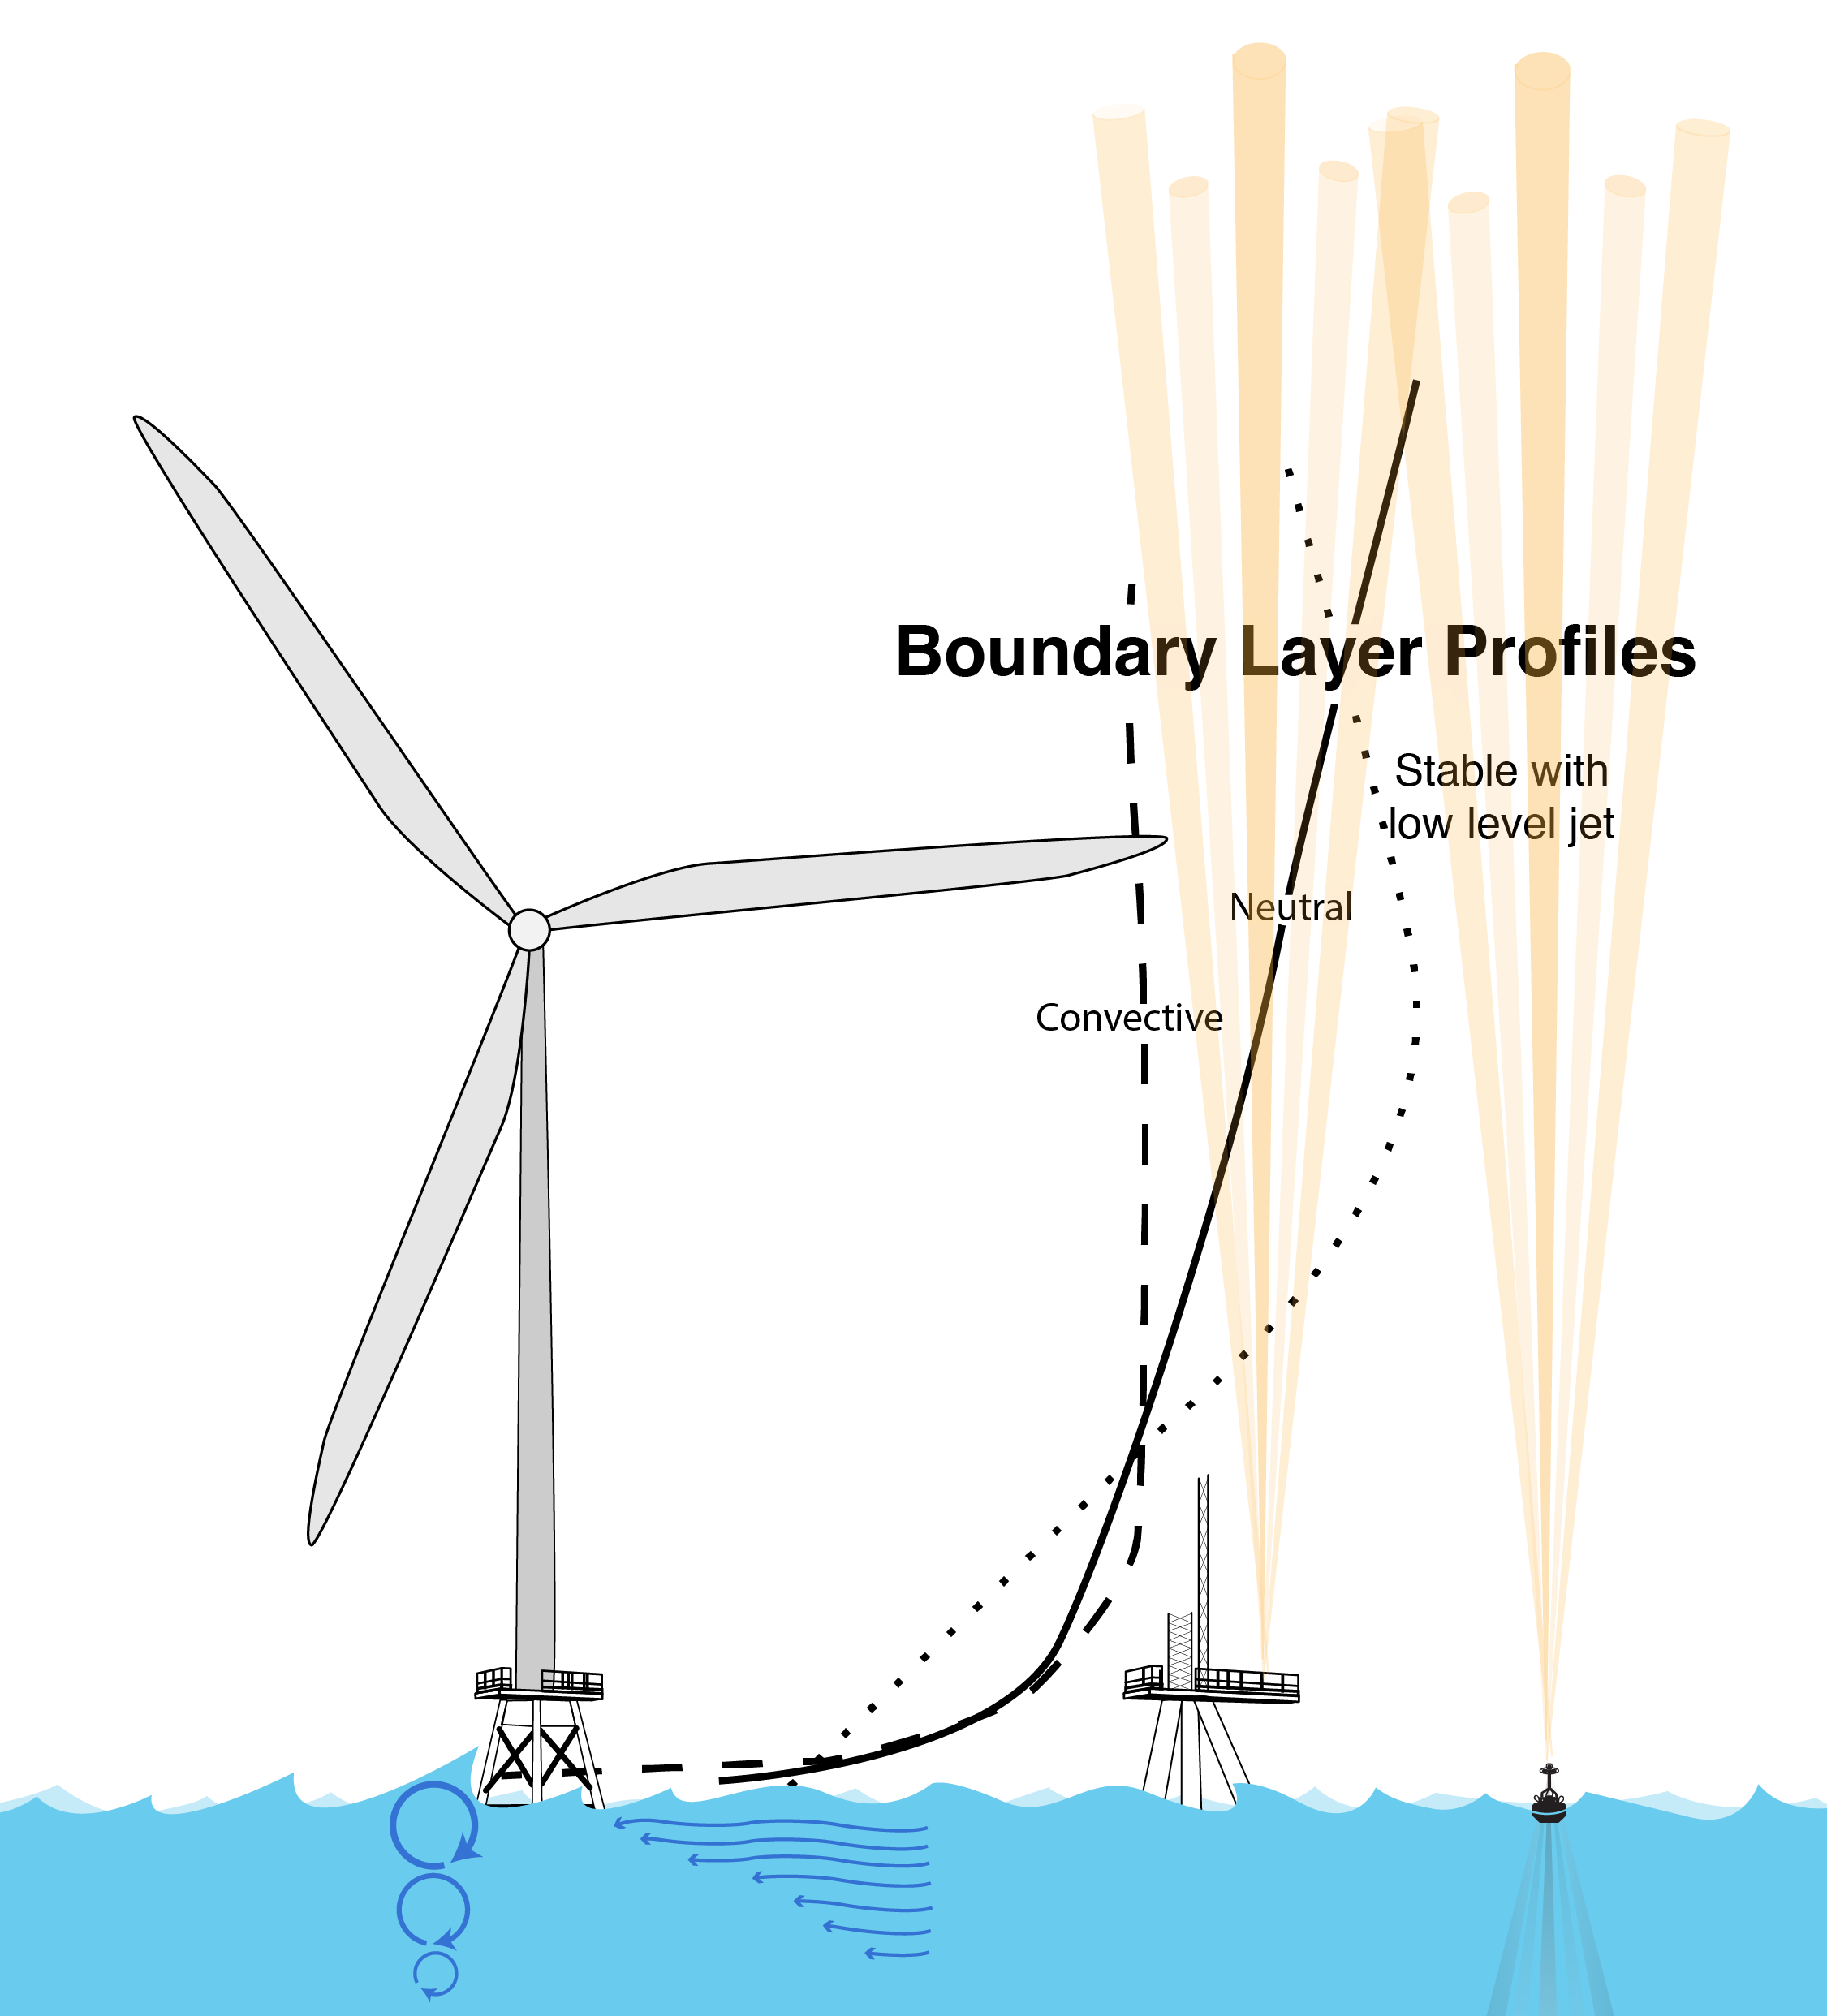
Background
Ever growing offshore turbine heights pose challenges
Traditional hub height wind speed in estimating power output fails, due to inconsistent wind shear at across the rotor plane. Rotor equivalent wind speed approach is inevitable
Tip of a turbine can penetrate deep into the atmospheric boundary layer (ABL), where winds vary with height
Distinct types wind profiles
Significant influence of atmospheric stability parameters (wind shear and turbulence intensity) on wind power estimation and turbine loading
Underscores the importance of characterizing wind profiles

Slide 3
Problem Statement
Challenges in estimating wind profiles across rotor plane
Scarcity of tall tower datasets
Extrapolation of surface measurements using similarity theory-based and/or empirical equations
logarithmic law of the wall
Monin-Obukhov similarity theory
Power law
Mesoscale models - Expensive
ML models extrapolating near surface winds to specific rotor-swept heights
Deep Neural Networks
Random Forest
Extreme Gradient Boosting (XGBoost)
Proposed Methodology
Provided large-scale meteorological features from ERA5, is it possible to estimate wind profiles using a DL model?
Methodology invariant to target dataset through the utilization of Chebyshev polynomial approximation
State-of-the-art TabNet, an attention-based sequential deep learning model
To mimic the measure-correlate-predict (MCP) approach, train the DL model for one year and predict for another
Assess the correlation of wind profiles with associated atmospheric conditions

Slide 4
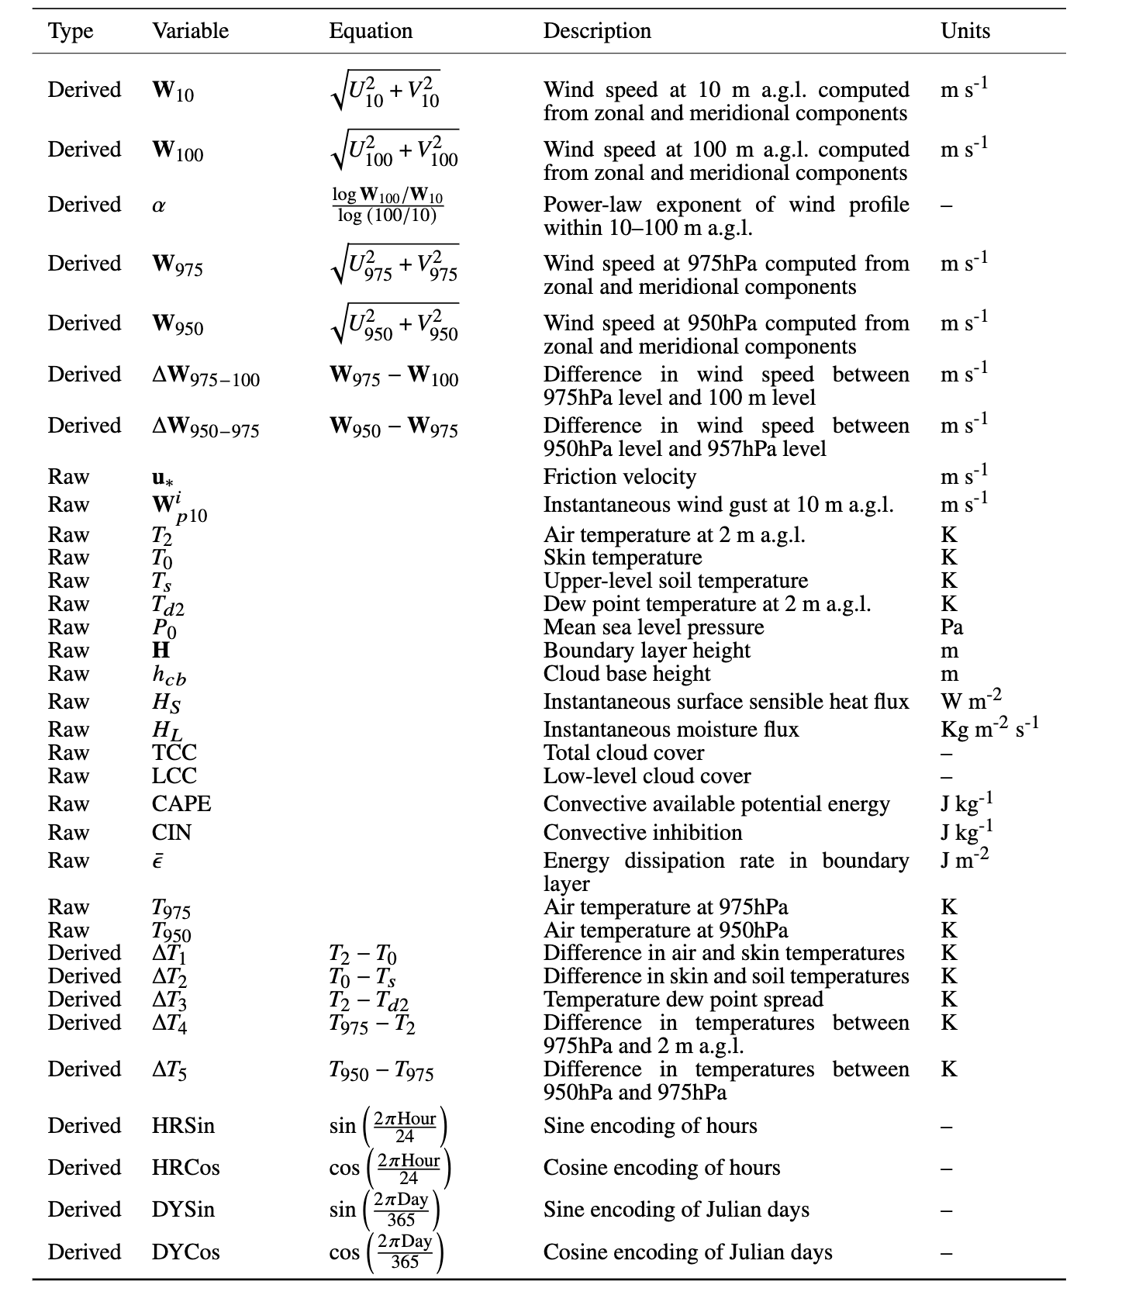
Data
As a proof-of-concept
34 ERA5 reanalysis meteorological features as inputs
CERRA reanalysis wind speed data at 12 vertical levels: 10, 15, 30, 50, 75, 100, 150, 200, 250, 300, 400, and 500 meters above sea level as targets
Point-based time-series data at FINO1 site (54.0143N, 6.58385E), well known for several wind meteorological studies
Data during 0000UTC on 1st of Jan 2000 to 2300UTC on 31st of Dec 2021

Slide 5
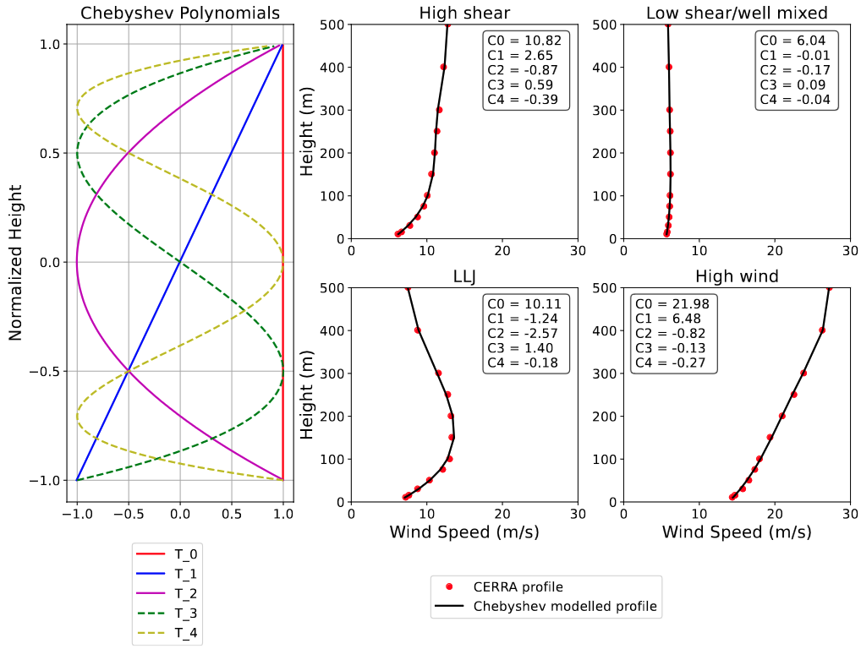
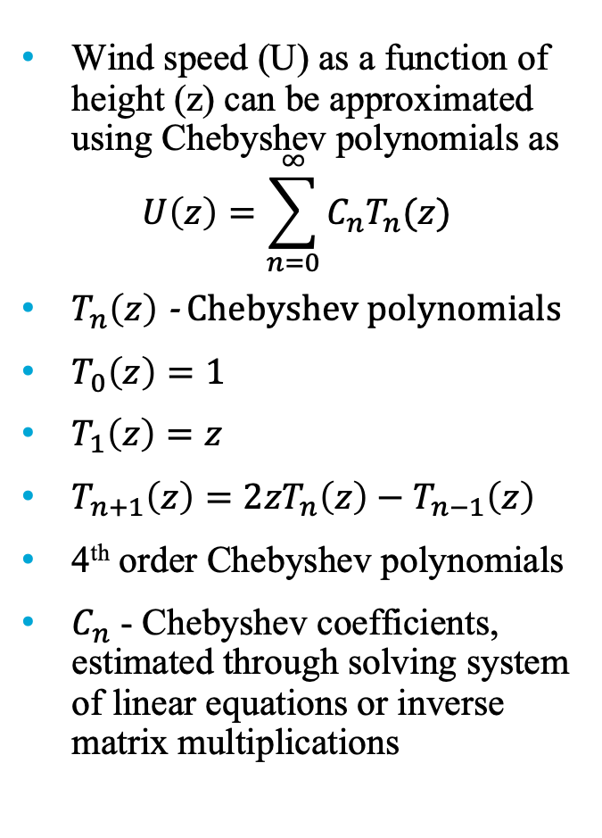
Estimating Chebyshev coefficients
Wind speed (U) as a function of height (z) can be approximated using Chebyshev polynomials as
$$U\left(z\right)=\sum_{n=0}^{∞}{C_{n}T_{n}(z)}$$
$T_{n}\left(z\right)$ - Chebyshev polynomials
$T_{0}\left(z\right)=1$
$T_{1}\left(z\right)=z$
$T_{n+1}\left(z\right)=2zT_{n}\left(z\right)−T_{n−1}\left(z\right)$
4th order Chebyshev polynomials
$C_{n}$ - Chebyshev coefficients, estimated through solving system of linear equations or inverse matrix multiplications

Slide 6
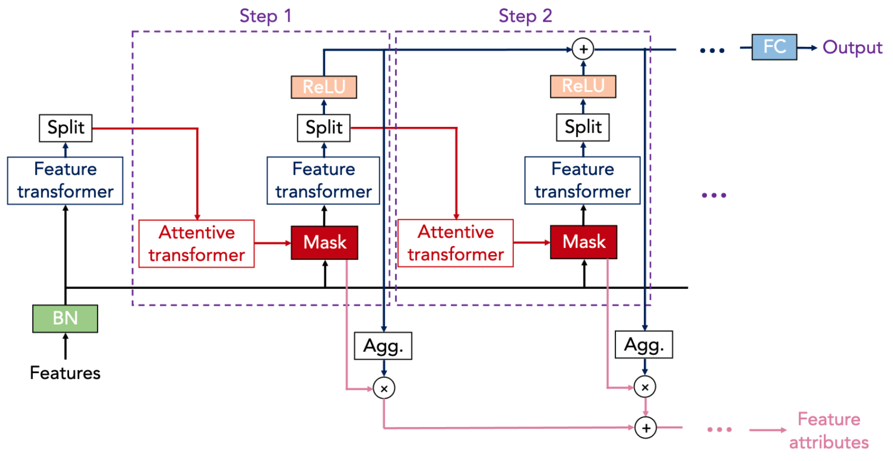
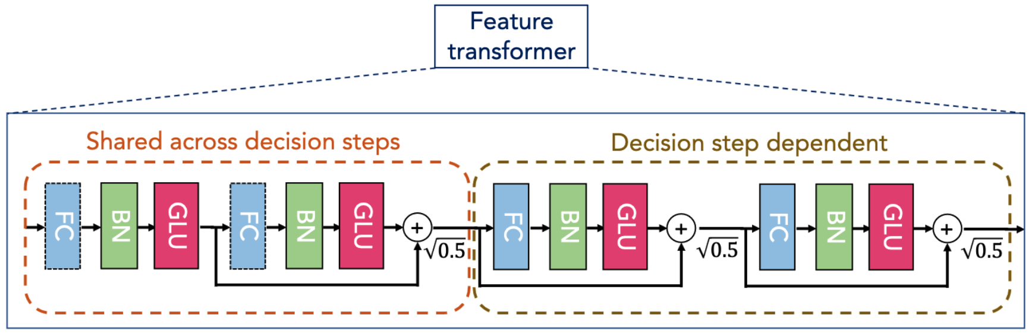
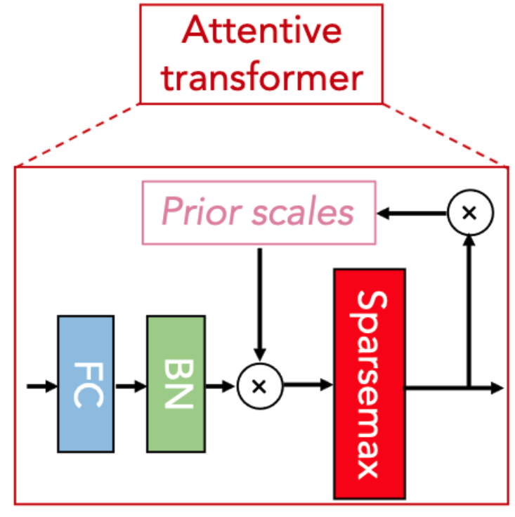
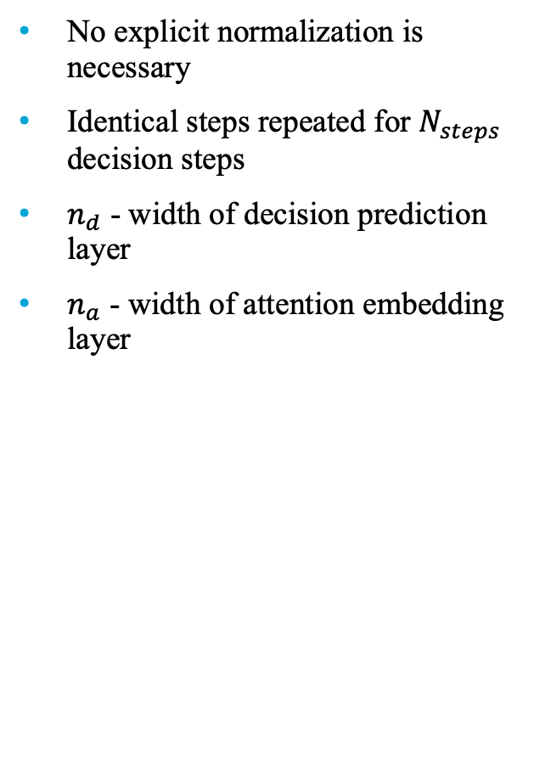
TabNet
No explicit normalization is necessary
Identical steps repeated for $N_{steps}$ decision steps
$n_{d}$ - width of decision prediction layer
$n_{a}$ - width of attention embedding layer

Slide 7
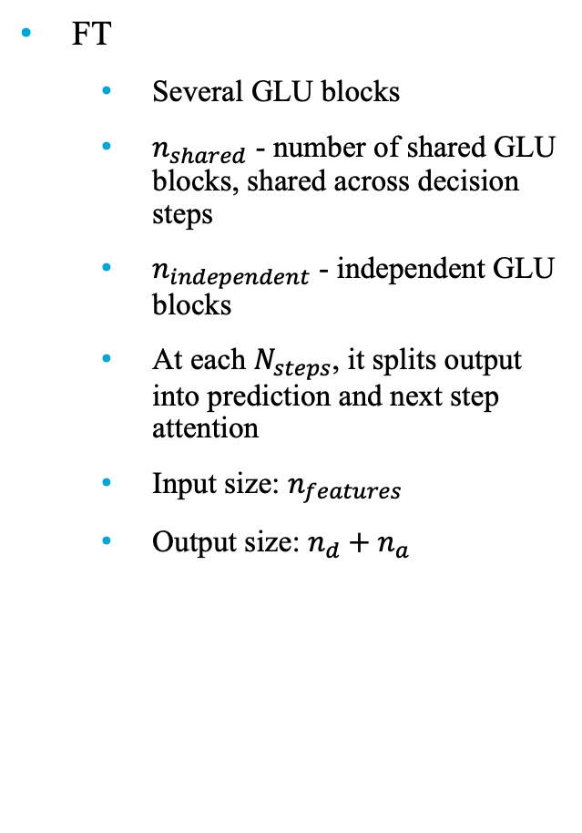
TabNet
FT
Several GLU blocks
$n_{shared}$ - number of shared GLU blocks, shared across decision steps
$n_{independent}$ - independent GLU blocks
At each $N_{steps}$, it splits output into prediction and next step attention
Input size: $n_{features}$
Output size: $n_{d}+n_{a}$

Slide 8
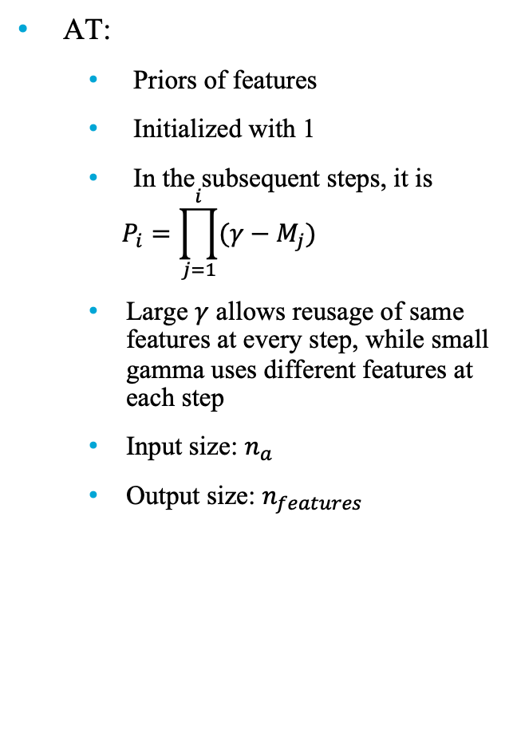
TabNet
AT:
Priors of features
Initialized with 1
In the subsequent steps, it is
$$P_{i}=\prod_{j=1}^{i}{(γ−M_{j})}$$
Large $γ$ allows reusage of same features at every step, while small gamma uses different features at each step
Input size: $n_{a}$
Output size: $n_{features}$

Slide 9
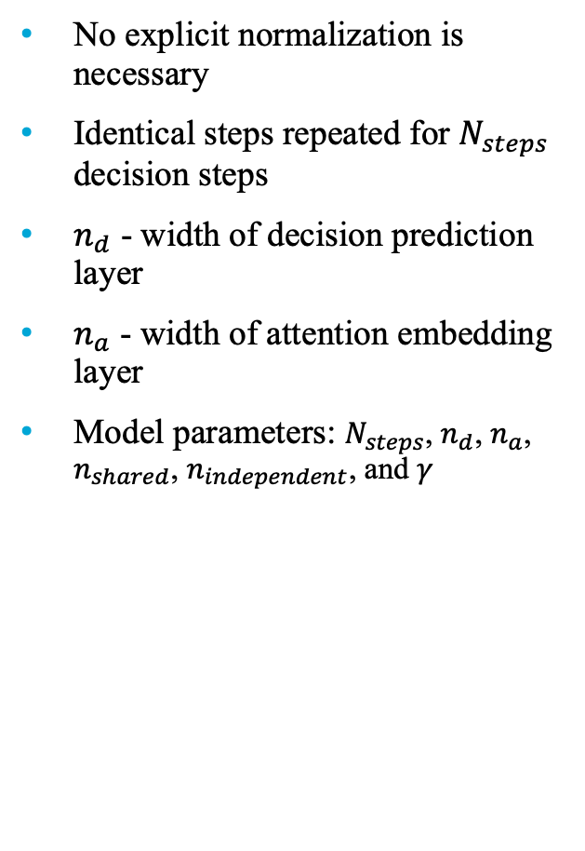
TabNet
No explicit normalization is necessary
Identical steps repeated for $N_{steps}$ decision steps
$n_{d}$ - width of decision prediction layer
$n_{a}$ - width of attention embedding layer
Model parameters: $N_{steps}$, $n_{d}$, $n_{a}$, $n_{shared}$, $n_{independent}$, and $γ$

Slide 10
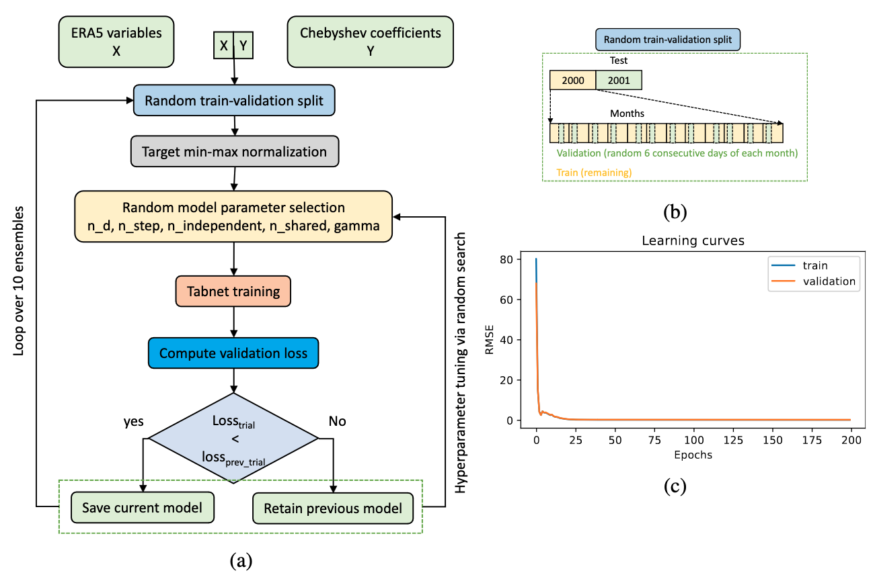
Experimental setup

Slide 11
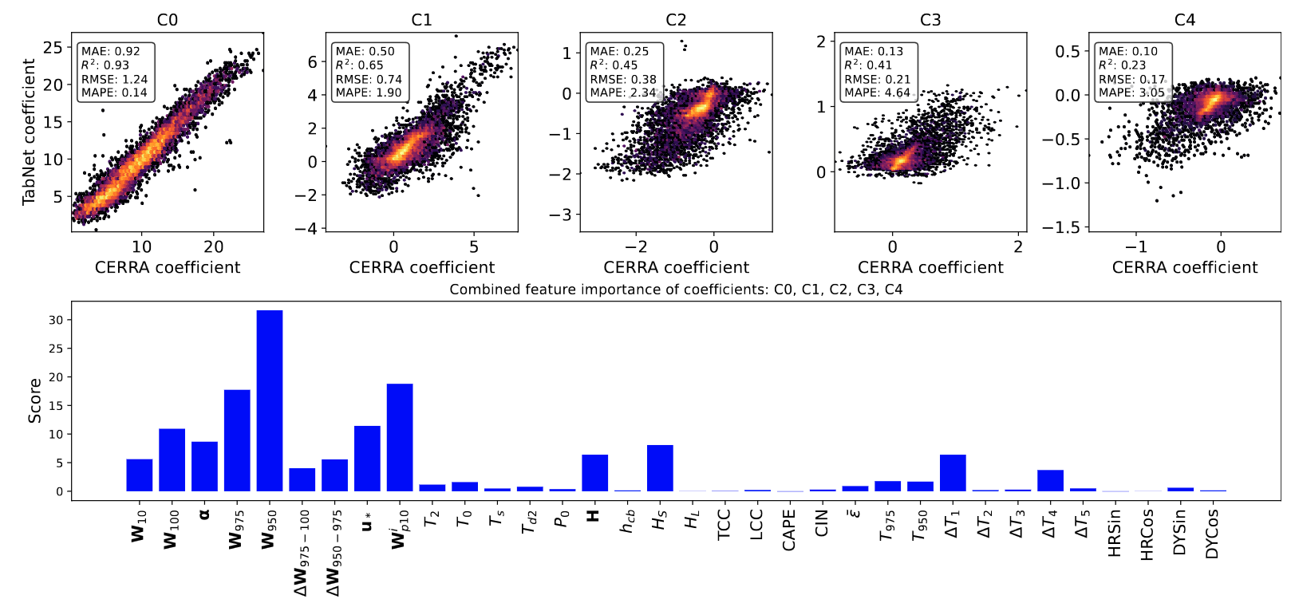
Results

Slide 12
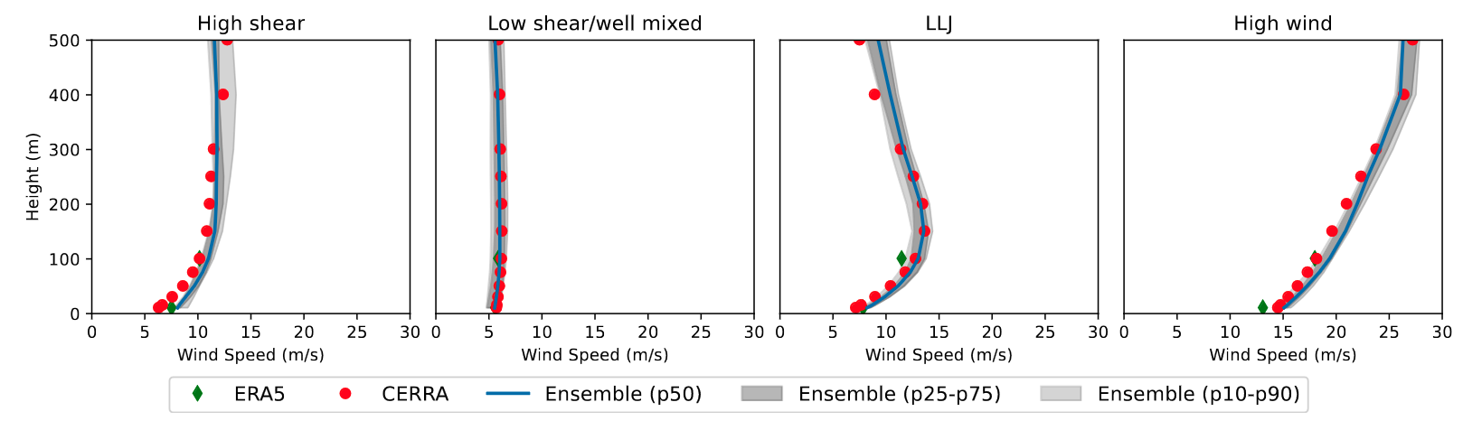
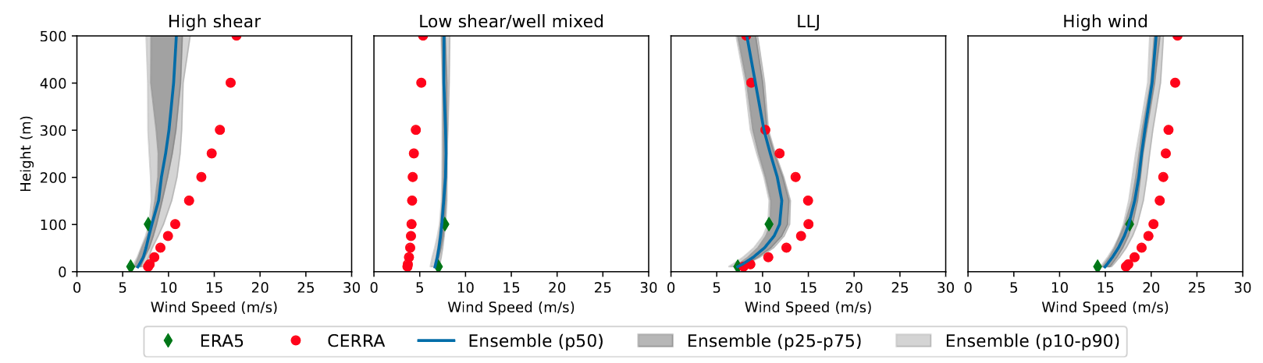
Results

